Slide 1

Remix3D/BabylonJS Animated GIFs Export
Anthony Powell
MICROSOFT CONFIDENTIAL. DO NOT DISTRIBUTE.

Slide 2
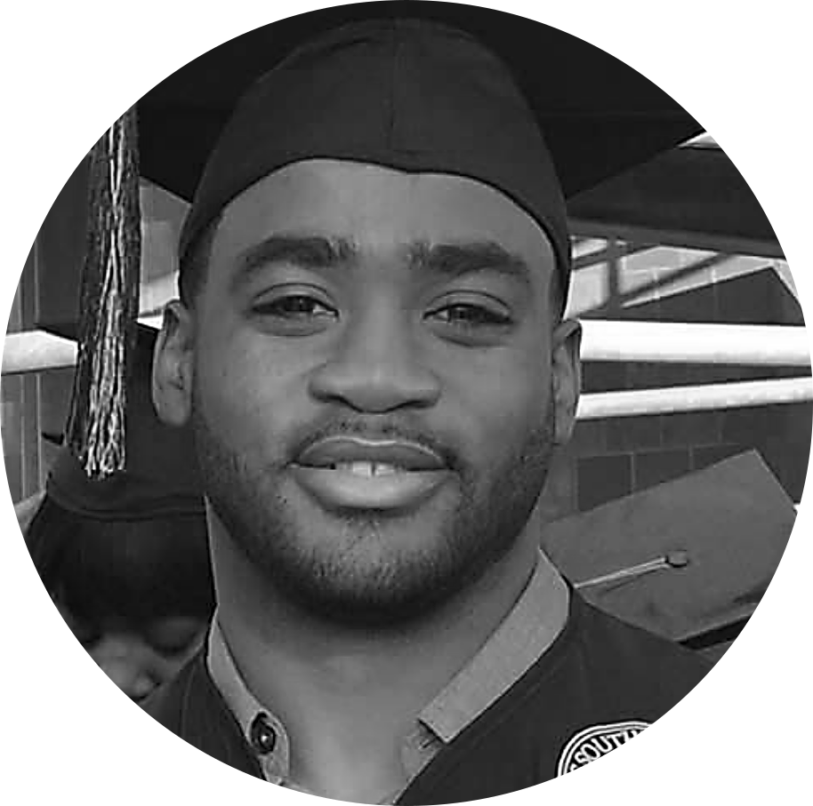
WHO ME?
Anthony Powell
Texas Southern University
Radiant Cloud
Manager: Mark Larsen
Mentor: Eddie Willett
MICROSOFT CONFIDENTIAL. DO NOT DISTRIBUTE.

Slide 3
OVERVIEW
MICROSOFT CONFIDENTIAL. DO NOT DISTRIBUTE.
Notes:
Big Design Question:
How can Remix3D story tell user engagement in a way that brings people back to the site time and time again?
Are

Slide 4
Intro Project & Definitions Why Solution Demo My Pain Points Next Steps What Did I Learn
MICROSOFT CONFIDENTIAL. DO NOT DISTRIBUTE.
Notes:
Big Design Question:
How can Remix3D story tell user engagement in a way that brings people back to the site time and time again?
Are

Slide 5
Remix3D/BabylonJS Animated GIFs Export
Enable exporting of BabylonJS creation as animated GIF.
MICROSOFT CONFIDENTIAL. DO NOT DISTRIBUTE.

Slide 6
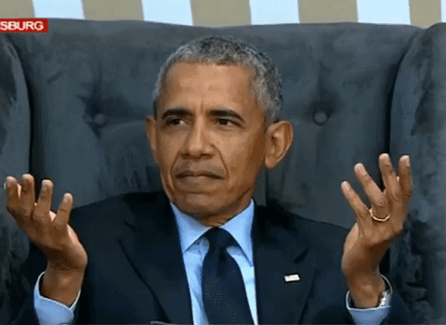

Slide 7

GIF
Graphics Interchange Format
is a bitmap image format developed by a team at CompuServe led by American computer scientist Steve Wilhite in 1987.
It is most known for its widespread usage on the World Wide Web due to its wide support and portability
MICROSOFT CONFIDENTIAL. DO NOT DISTRIBUTE.

Slide 8
YOU ARE A CREATOR
BabylonJS is a complete JavaScript framework for building 3D games and experiences on the web.
MICROSOFT CONFIDENTIAL. DO NOT DISTRIBUTE.

Slide 9
WHY
MICROSOFT CONFIDENTIAL. DO NOT DISTRIBUTE.
Notes:
Big Design Question:
How can Remix3D story tell user engagement in a way that brings people back to the site time and time again?
Are

Slide 10
TIME
PROCESS
Make creation
Upload creation
Share a link
Navigate to site
Wait load
View creation
ACCESSIBILITY
MICROSOFT CONFIDENTIAL. DO NOT DISTRIBUTE.

Slide 11

CURRENT SHARING REQUIREMENTS
Modern Computer
Modern Cell Phone
Reliable Internet
Microsoft Account
Social Media
MICROSOFT CONFIDENTIAL. DO NOT DISTRIBUTE.

Slide 12
EDUCATION
Viewing at home
Sharing with family and friends
Viewing on low fi devices
Sharing on the go
BUSINESS
SOCIAL
Time is money
MEMEs the word
Additional work
MICROSOFT CONFIDENTIAL. DO NOT DISTRIBUTE.

Slide 13
Broadband Connection
PEW RESEARCH CENTER
65%
20%
U.S.
2018
Mobile Only
2018
57%
Mississippi
2016
MICROSOFT CONFIDENTIAL. DO NOT DISTRIBUTE.

Slide 14
Low Income
Rural Communities
ACCESSIBILITY
MICROSOFT CONFIDENTIAL. DO NOT DISTRIBUTE.
Notes:
Big Design Question:
How can Remix3D story tell user engagement in a way that brings people back to the site time and time again?
Are

Slide 15
WHAT IF?
Share or preview your work on systems with
slow internet speeds
low-fi system
Shared and embedded directly with
Emails
Text messages
Social media
MICROSOFT CONFIDENTIAL. DO NOT DISTRIBUTE.

Slide 16
SOLUTION
MICROSOFT CONFIDENTIAL. DO NOT DISTRIBUTE.
Notes:
Big Design Question:
How can Remix3D story tell user engagement in a way that brings people back to the site time and time again?
Are

Slide 17
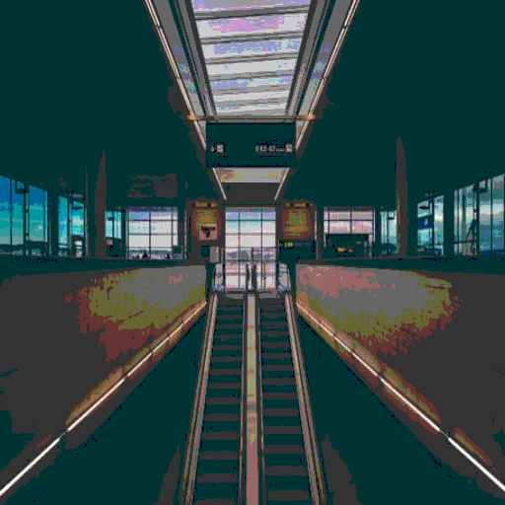
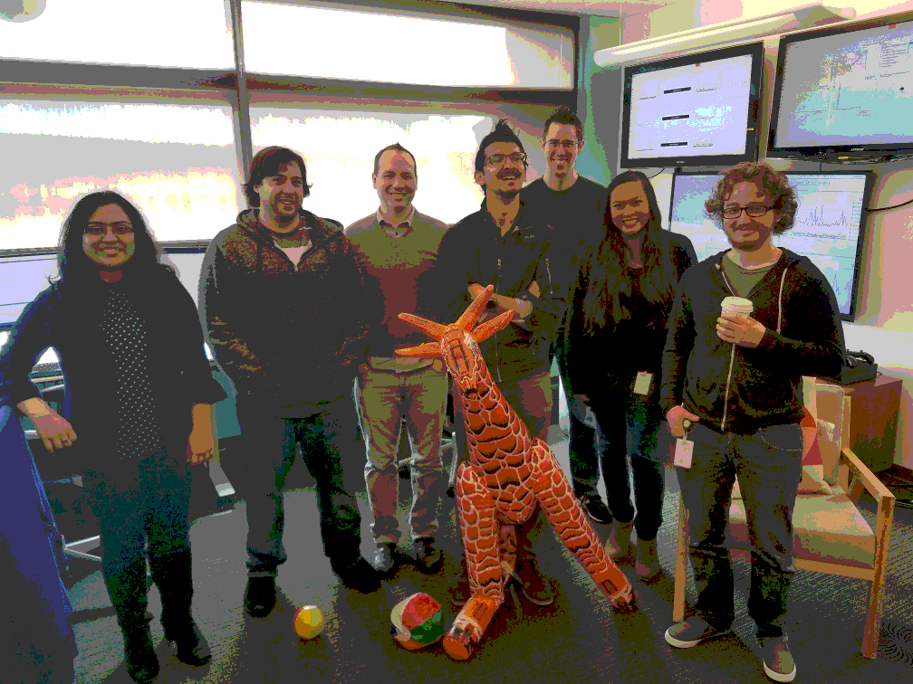
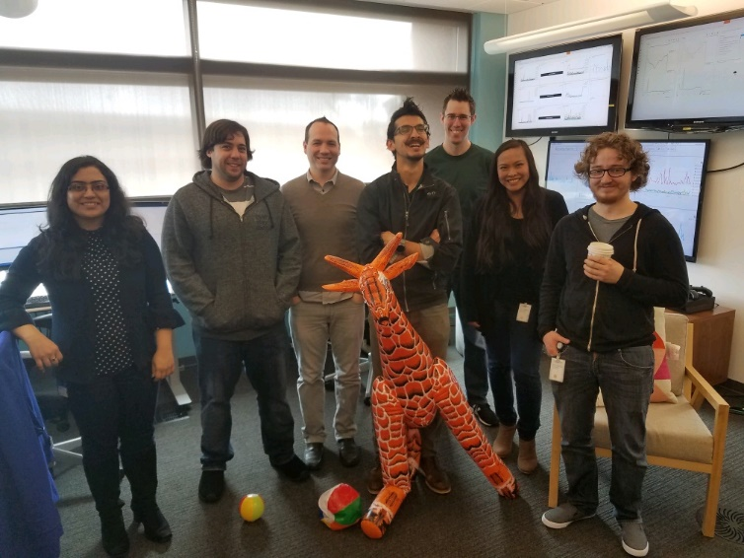
Stage 1
MICROSOFT CONFIDENTIAL. DO NOT DISTRIBUTE.

Slide 18


Stage 2
MICROSOFT CONFIDENTIAL. DO NOT DISTRIBUTE.

Slide 19

Stage 3
MICROSOFT CONFIDENTIAL. DO NOT DISTRIBUTE.

Slide 20

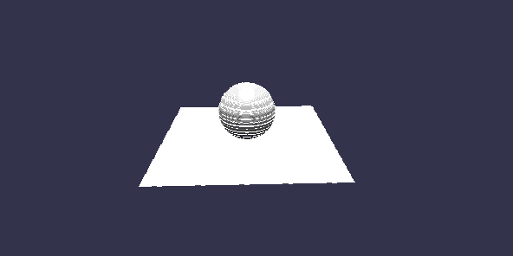
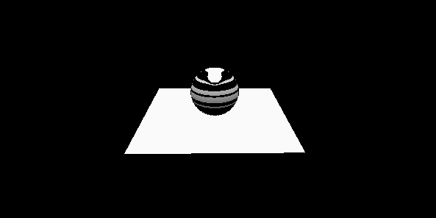
Stage 4
MICROSOFT CONFIDENTIAL. DO NOT DISTRIBUTE.

Slide 21

Stage 5
MICROSOFT CONFIDENTIAL. DO NOT DISTRIBUTE.

Slide 22
Stage 6
MICROSOFT CONFIDENTIAL. DO NOT DISTRIBUTE.

Slide 23

FINAL
MICROSOFT CONFIDENTIAL. DO NOT DISTRIBUTE.

Slide 24
DEMO
MICROSOFT CONFIDENTIAL. DO NOT DISTRIBUTE.
Notes:
Big Design Question:
How can Remix3D story tell user engagement in a way that brings people back to the site time and time again?
Are

Slide 25
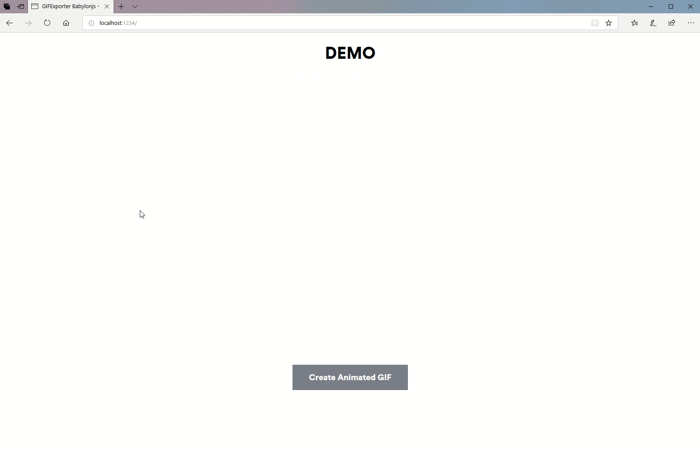
MICROSOFT CONFIDENTIAL. DO NOT DISTRIBUTE.
Notes:
Big Design Question:
How can Remix3D story tell user engagement in a way that brings people back to the site time and time again?
Are

Slide 26
PAIN POINTS
MICROSOFT CONFIDENTIAL. DO NOT DISTRIBUTE.
Notes:
Big Design Question:
How can Remix3D story tell user engagement in a way that brings people back to the site time and time again?
Are

Slide 27
GIF
Written in 1990
Completely New Experience
Image Processing
TYPESCRIPT
Library not an app
Compliance
Client-side processing
No native system hooks
MICROSOFT CONFIDENTIAL. DO NOT DISTRIBUTE.

Slide 28
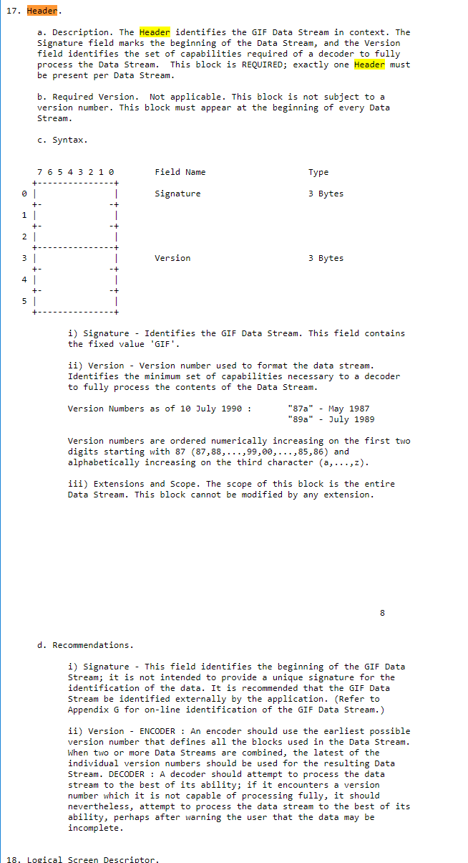
MICROSOFT CONFIDENTIAL. DO NOT DISTRIBUTE.

Slide 29
FUTURE WORK
MICROSOFT CONFIDENTIAL. DO NOT DISTRIBUTE.
Notes:
Big Design Question:
How can Remix3D story tell user engagement in a way that brings people back to the site time and time again?
Are

Slide 30

Test web assembly performance possibilities.
Test optimal color quantizing algorithms.
Get folks using it RIGHT NOW!
Work with open source community to ensure functionality.
MICROSOFT CONFIDENTIAL. DO NOT DISTRIBUTE.

Slide 31
Enjoy Life
Ask ?s
NOT THE MIILITARY
Talk to People
WHAT DID I LEAN
There’s a Different World
MICROSOFT CONFIDENTIAL. DO NOT DISTRIBUTE.
Notes:
Big Design Question:
How can Remix3D story tell user engagement in a way that brings people back to the site time and time again?
Are

Slide 32

QUESTIONS
MICROSOFT CONFIDENTIAL. DO NOT DISTRIBUTE.
Notes:
Big Design Question:
How can Remix3D story tell user engagement in a way that brings people back to the site time and time again?
Are

Slide 33
What did I learn Process -> from Remix Download to functionality to BabylonJS.
MICROSOFT CONFIDENTIAL. DO NOT DISTRIBUTE.
Notes:
Big Design Question:
How can Remix3D story tell user engagement in a way that brings people back to the site time and time again?
Are

